Slide 1
Data Mining: Concepts and Techniques Data Preprocessing
Jiawei Han, Micheline Kamber, and Jian Pei
University of Illinois at Urbana-Champaign &
Simon Fraser University
©2013 Han, Kamber & Pei. All rights reserved.
Revised by Jared
1
Notes:
1

Slide 2
上周内容回顾：Know Your Data: Outline
Data Objects and Attribute Types
Basic Statistical Descriptions of Data
Data Visualization
Measuring Data Similarity and Dissimilarity

Slide 3
Data Preprocessing: Outline
Data Preprocessing: An Overview
Data Quality
Major Tasks in Data Preprocessing
Data Cleaning
Data Integration
Data Reduction
Data Transformation
Linear Algebra (线性代数)
Summary
3

Slide 4


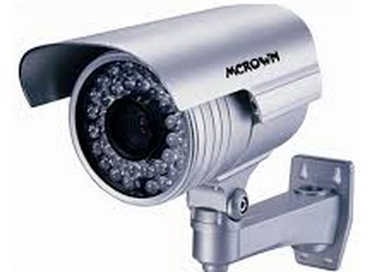



Data Quality: Why Preprocess the Data?
Let us take “photo” as an example
（1）照片采集
（3）照片冲洗后保存
（2）照片传输、显示
4

Slide 5




Data Quality: Why Preprocess the Data?
For instance:
真实应用中的图像
往往含有不同的噪音或像素破坏
因人工错误标定形成的异类数据
指纹归属错误
直接负面影响
数据描述或预测性能
鸟的类型标定错误
This is the major reason why data preprocessing is very important for subsequent data analysis and mining task.
5

Slide 6
Data Quality: How to Measure Data Quality?
Measures for data quality: A multidimensional view
Accuracy: correct or wrong, accurate or not
Completeness: not recorded, unavailable, …
Consistency: some modified but some not, …
Timeliness: timely update?
Believability: how trustable the data are correct?
Interpretability: how easily the data can be understood?

Slide 7
Major Tasks in Data Preprocessing
Data cleaning
Fill in missing values, smooth noisy data, identify or remove outliers, and resolve inconsistencies
Data integration
Integration of multiple databases, data cubes, or files
Data reduction
Dimensionality reduction
Numerosity reduction
Data compression
Data transformation
Normalization

Slide 8
Data Preprocessing: Outline
Data Preprocessing: An Overview
Data Quality
Major Tasks in Data Preprocessing
Data Cleaning
Data Integration
Data Reduction
Data Transformation
Linear Algebra (线性代数)
Summary
8

Slide 9
Data Cleaning
Data in the Real World Is Dirty: Lots of potentially incorrect data, e.g., instrument faulty, human or computer error, transmission error
incomplete: lacking attribute values, lacking certain attributes of interest, or containing only aggregate data
e.g., Occupation = “ ” (missing data)
noisy: containing noise, errors, or outliers
e.g., Salary = “−10” (an error)
inconsistent: containing discrepancies in codes or names, e.g.,
Age = “42”, Birthday = “03/07/2010”
Was rating “1, 2, 3”, now rating “A, B, C”
discrepancy (差异) between duplicate （重复的）records
Intentional （故意的）(e.g., disguised missing data 变相的缺失数据)
Jan. 1 as everyone’s birthday?

Slide 10
Incomplete (Missing) Data
Data is not always available
E.g., many tuples （元组）have no recorded value for several attributes, such as customer income in sales data
Missing data may be due to
equipment malfunction （故障）
inconsistent with other recorded data and thus deleted
data not entered due to misunderstanding
certain data may not be considered important at the time of entry
not register history or changes of the data
Missing data may need to be inferred or estimated

Slide 11
How to Handle Missing Data?
Ignore the tuple: usually done when class label is missing (when doing classification)— not effective when the % of missing values per attribute varies considerably (差异很大)
Fill in the missing value manually: Q: feasible? Why?
Fill in it automatically with
a global constant : e.g., “unknown”, a new class?!
the attribute mean
the attribute mean for all samples belonging to the same class
the most probable value: inference-based （基于推理的）such as Bayesian formula or decision tree

Slide 12
Noisy Data
Noise: random error or variance in a measured variable
Incorrect attribute values may be due to
faulty data collection instruments
data entry problems
data transmission problems
technology limitation
inconsistency in naming convention （命名规则）
Other data problems which require data cleaning
duplicate records
incomplete data
inconsistent data
12
Notes:
12

Slide 13
How to Handle Noisy Data?
Binning （分级）
first sort data and partition into (equal-frequency) bins
then one can smooth by bin means, smooth by bin median, smooth by bin boundaries, etc.
Regression
smooth by fitting the data into regression functions
Clustering
detect and remove outliers
Combined computer and human inspection （人机检查）
detect suspicious （可疑的） values and check by human (e.g., deal with possible outliers)
Notes:
Enrich using data integration research!!

Slide 14
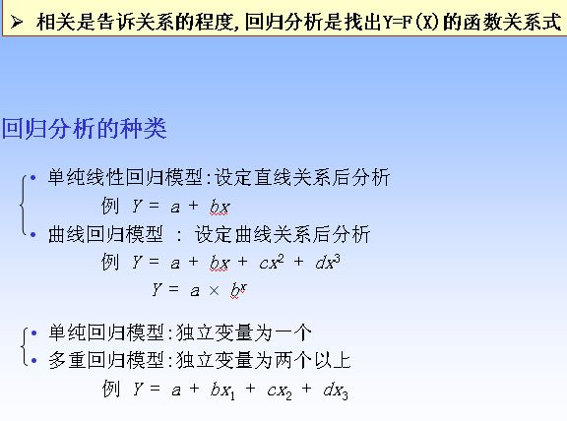
回归分析（Regression Analysis）
y
Y1
Y1’
y = x + 1
X1
x

Slide 15
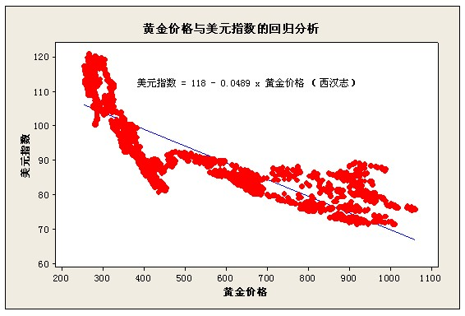
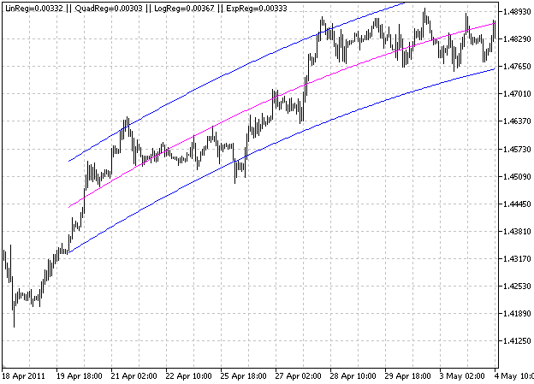
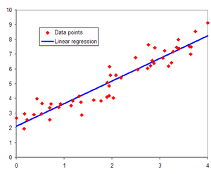
回归分析
回归分析
（Regression
Analysis）

Slide 16

Outliers - Example
Outliers are data objects with characteristics that are considerably different than most of the other data objects in the data set
Are they noise points, or meaningful outliers?

Slide 17
Data Preprocessing: Outline
Data Preprocessing: An Overview
Data Quality
Major Tasks in Data Preprocessing
Data Cleaning
Data Integration
Data Reduction
Data Transformation
Linear Algebra (线性代数)
Summary
17

Slide 18
Data Integration
Data integration:
Combines data from multiple sources into a coherent store （统一存储）
Schema integration （架构整合）: e.g., A.cust-id ≡ B.cust-#
Integrate metadata from different sources
Entity identification problem （实体鉴别问题）:
Identify real world entities from multiple data sources, e.g., Bill Clinton = William Clinton
Detecting and resolving data value conflicts:
For the same entity, attribute values from different sources are different
Possible reasons: different representations, different scales, e.g., metric vs. British units （公制与英制单位）
18
Notes:
Should ask students to do some survey on data integration. -JH

Slide 19
Handling Redundancy in Data Integration
Redundant data （冗余数据） often occurs when integration of multiple databases
Object identification: The same attribute or object may have different names in different databases
Derivable data: One attribute may be a “derived” attribute in another table, e.g., annual income
Redundant attributes may be able to be detected by correlation analysis and covariance analysis
Careful integration of the data from multiple sources may help reduce/avoid redundancies and inconsistencies and improve mining speed and quality
19

Slide 20
Correlation Analysis (Numeric Data)
For two variable sets A and B, the correlation coefficient (also called Pearson’s product moment coefficient) is defined as
where n is the number of tuples, and are the respective means of A and B, σ_{A} and σ_{B} are the respective standard deviation of A and B, and Σ(a_{i}b_{i}) is the sum of the AB cross-product.
If r_{A,B} > 0, A and B are positively correlated. The higher, the stronger correlation.
If r_{A,B} = 0: independent, or if r_{AB} < 0: negatively correlated

Slide 21
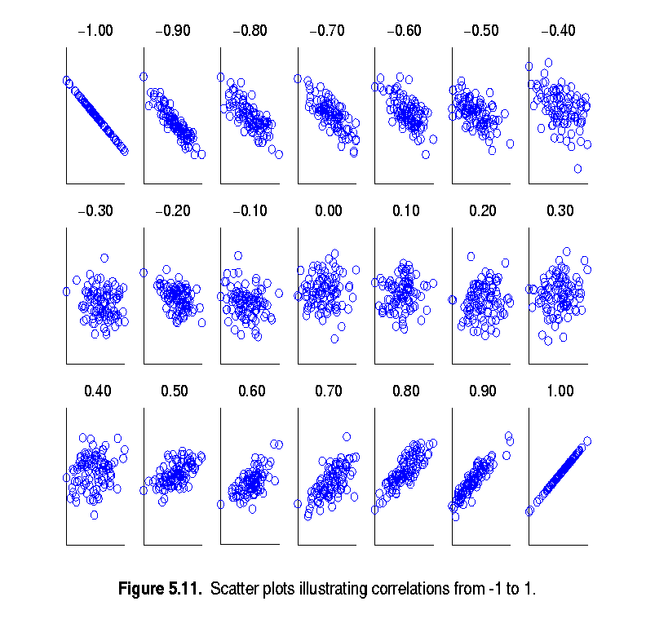
Visually Evaluating Correlation
Scatter plots showing the similarity from –1 to 1.
-1: negatively correlated
0: independent
1: positively correlated

Slide 22
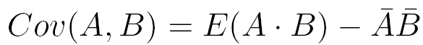
Co-Variance (协方差): An Example
It can be simplified in computation as
协方差表示的是两个变量的总体误差，这与只表示一个变量误差的方差不同。 两个变量A和B之间的协方差可定义为：

Slide 23
Co-Variance (协方差): An Example
Suppose two stocks A and B have the following values in one week: (2, 5), (3, 8), (5, 10), (4, 11), (6, 14).
Question: If the stocks are affected by the same industry trends, will their prices rise or fall together?
E(A) = (2 + 3 + 5 + 4 + 6)/ 5 = 20/5 = 4
E(B) = (5 + 8 + 10 + 11 + 14) /5 = 48/5 = 9.6
Cov(A,B) = (2×5+3×8+5×10+4×11+6×14)/5 − 4 × 9.6 = 4
Thus, A and B rise or fall together since Cov(A, B) > 0.
如果两个变量的变化趋势一致，也就是说如果变量值同时大于或小于自身的期望值，那么两个变量之间的协方差就是正值。 如果两个变量的变化趋势相反，即其中一个大于自身的期望值，另外一个却小于自身的期望值，那么两个变量之间的协方差就是负值。

Slide 24
Data Preprocessing: Outline
Data Preprocessing: An Overview
Data Quality
Major Tasks in Data Preprocessing
Data Cleaning
Data Integration
Data Reduction
Data Transformation
Linear Algebra (线性代数)
Summary
24
Notes:
24

Slide 25
Data Reduction Strategies
Data reduction: Obtain a reduced representation of the data set that is much smaller in volume but yet produces the same (or almost the same) analytical results
Why data reduction? — A database/data warehouse may store terabytes of data. Complex data analysis may take a very long time to run on the complete data set.
Data reduction strategies
Dimensionality reduction, e.g., remove unimportant attributes
Wavelet transforms, Principal Components Analysis (PCA)
Feature subset selection, feature creation, …
Numerosity reduction (some simply call it: Data Reduction)
Regression and Log-Linear Models
Histograms, clustering, sampling
Data cube aggregation (数据立方体聚集)
Data compression
Image compression: Sparse Coding, Low-rank Recovery, …
Notes:
MK 09/09/05: Wiki has dimensionality reduction as feature extraction (PCA) and feature subset selection. It states both wavelet transforms and PCA as forms of data compression. It does not have any pages for "numerosity reduction". We claim there are many different ways to organize data reduction strategies, which is true, so this presentation below should be OK. Let’s discuss.

Slide 26
Data Reduction Strategies
Data reduction strategies
Dimensionality reduction, e.g., remove unimportant attributes
Wavelet transforms
Principal Components Analysis (PCA)
Feature subset selection, feature creation
Curse of dimensionality
When dimensionality increases, data becomes increasingly sparse
If the number of features d is large, the number of samples n may be too small for accurate parameter estimation.
Density and distance between points, which is important to clustering, outlier analysis, becomes less meaningful
The possible combinations of subspaces will grow exponentially
Notes:
MK 09/09/05: Wiki has dimensionality reduction as feature extraction (PCA) and feature subset selection. It states both wavelet transforms and PCA as forms of data compression. It does not have any pages for "numerosity reduction". We claim there are many different ways to organize data reduction strategies, which is true, so this presentation below should be OK. Let’s discuss.

Slide 27
Data Reduction 1: Dimensionality Reduction
Dimensionality reduction
Avoid the curse of dimensionality
Help eliminate irrelevant features and reduce noise
Reduce time and space required in data mining
Allow easier visualization
Dimensionality reduction techniques
Wavelet transforms,
Principal Component Analysis,
Supervised and nonlinear techniques (e.g., feature selection)…
Notes:
27
JH: put SVD at clustering high-D reduction.

Slide 28
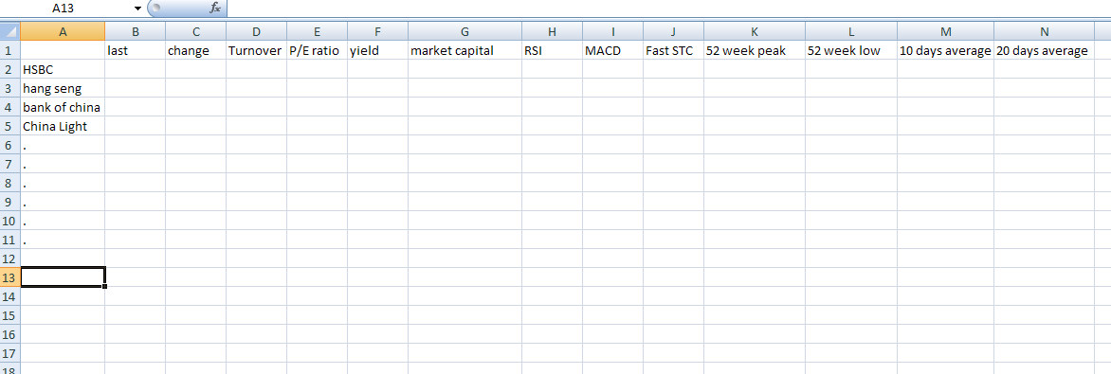
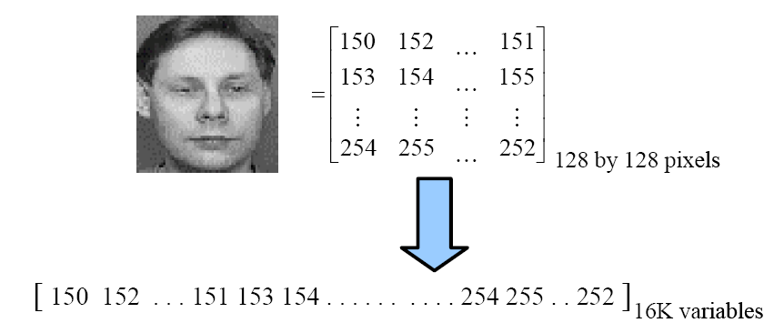
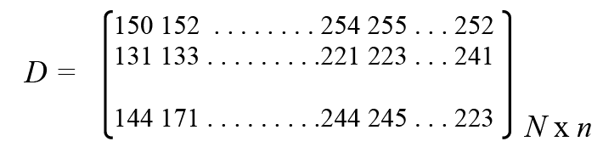
What is high Dimensional data set?
13-D financial
data set
Each pixel is considered as a variable
When we have N images, we have

Slide 29
常见的真实高维数据示例
人物面部图像 - 人脸检测或识别
手写体数字或字符图像 – 手写体识别或鉴别
指纹图像 – 指纹检测或识别
纹理图像 – 纹理检测与识别
虹膜图像 – 虹膜识别
。。。。。。

Slide 30
Data Reduction 1: Dimensionality Reduction
How？- 特征提取 vs 特征选择
特征提取（或特征学习，feature learning）: 通过特征映射 (mapping) 或投影变换(projection transformation) 对原始高维数据进行低维描述的过程。 即: Y=f(X): f 是一个映射 或 Y=W^{T}X: W 是投影矩阵, .
典型用途：图像、文档特征提取等。
此过程生成新特征。
特征选择（或特征排序， feature ranking）: 从给定高维数据中选出一组最具描述性的有效特征，从而达到降低空间维度的目的。
典型用途：基因选择 (gene selection) 等。
此过程不生成新特征。

Slide 31
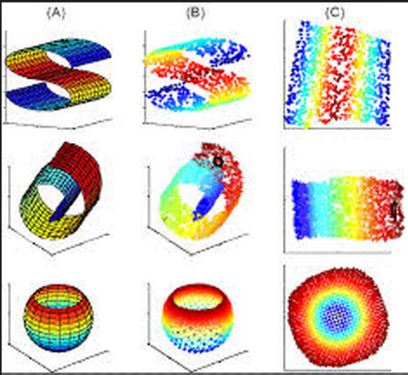
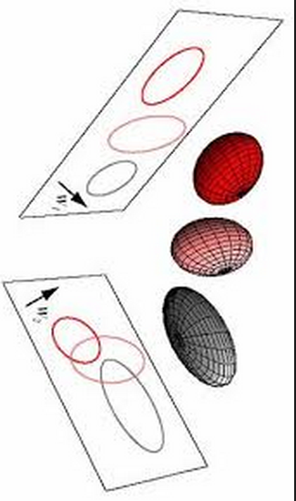
Data Reduction Strategies
Examples of dimensionality reduction by feature extraction:
Notes:
MK 09/09/05: Wiki has dimensionality reduction as feature extraction (PCA) and feature subset selection. It states both wavelet transforms and PCA as forms of data compression. It does not have any pages for "numerosity reduction". We claim there are many different ways to organize data reduction strategies, which is true, so this presentation below should be OK. Let’s discuss.

Slide 32
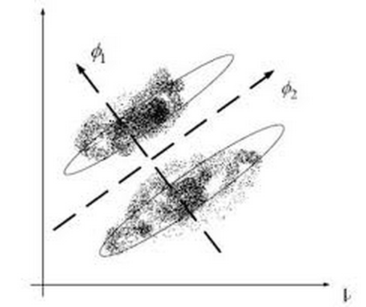
Data Reduction Strategies
Examples of dimensionality reduction by feature extraction:
Q: Which directions is better
and why?
Better projected embedding:
High inter-cluster separation
high intra-cluster compactness
Notes:
MK 09/09/05: Wiki has dimensionality reduction as feature extraction (PCA) and feature subset selection. It states both wavelet transforms and PCA as forms of data compression. It does not have any pages for "numerosity reduction". We claim there are many different ways to organize data reduction strategies, which is true, so this presentation below should be OK. Let’s discuss.

Slide 33
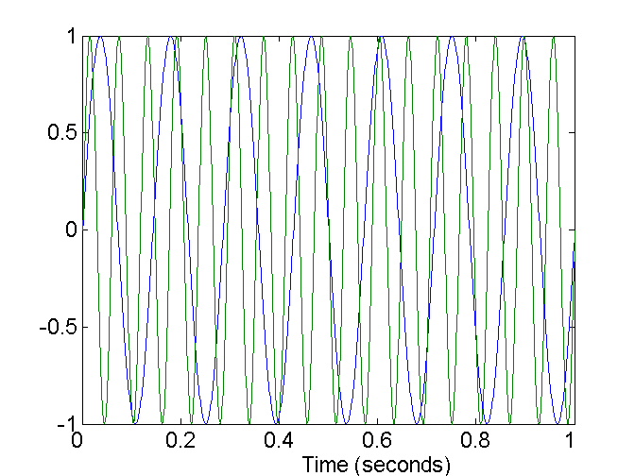
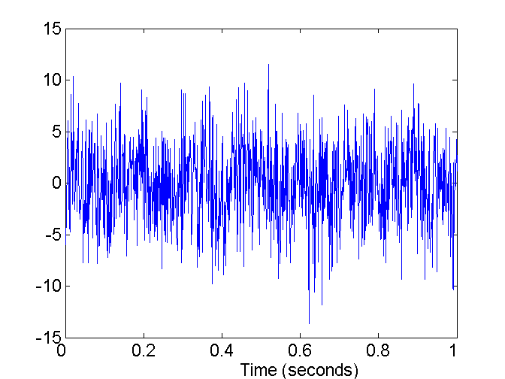
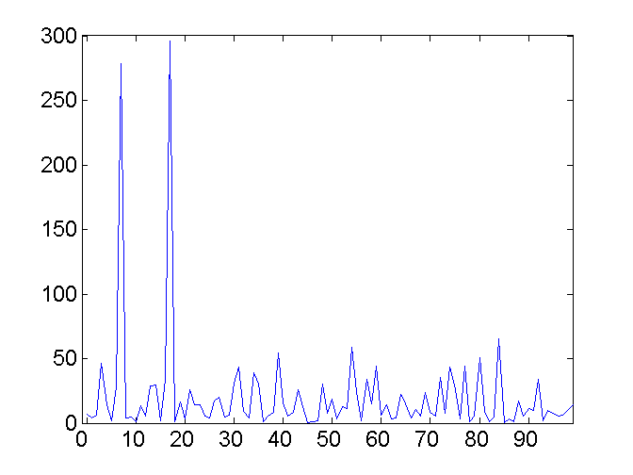
Mapping Data to a New Space
Fourier transform (傅里叶变换)
Wavelet transform (小波变换)
Two Sine Waves
Two Sine Waves + Noise
Frequency
Notes:
33

Slide 34
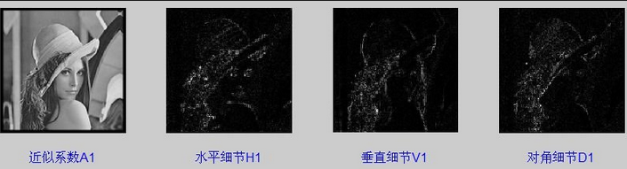
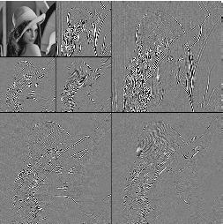
What Is Wavelet Transform?
Decomposes a
signal into different
frequency subbands
Applicable to n-dimensional signals
Data are transformed to preserve relative distance between objects at different levels of resolution
Allow natural clusters to become more distinguishable
Used for image compression
Notes:
34

Slide 35
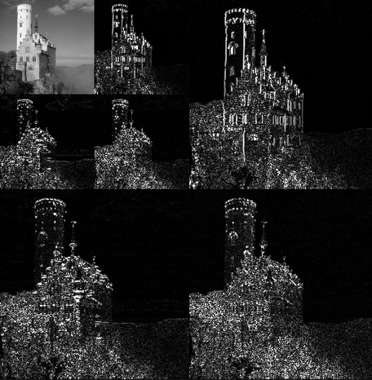
What Is Wavelet Transform?
Notes:
35

Slide 36
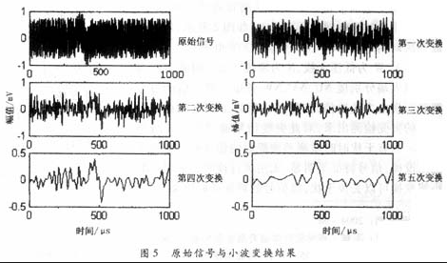
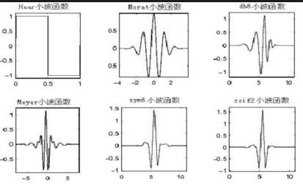
Some results by Wavelet Transform?
Notes:
36

Slide 37
Principal Component Analysis (PCA)
Find a projection that captures the largest amount of variation in data, by maximizing the covariance of data
The original data are projected onto a much smaller space, resulting in dimensionality reduction. We find the eigenvectors of the covariance matrix, and these eigenvectors define the new space
x₂
e
x₁

Slide 38
Principal Component Analysis (Steps)
Given N data vectors from n-dimensions, find k ≤ n orthogonal vectors (principal components) that can be best used to represent data
Normalize input data: Each attribute falls within the same range
Compute k orthonormal (unit) vectors, i.e., principal components
Each input data (vector) is a linear combination of the k principal component vectors
The principal components are sorted in order of decreasing “significance” or strength
Since the components are sorted, the size of the data can be reduced by eliminating the weak components, i.e., those with low variance (i.e., using the strongest principal components, it is possible to reconstruct a good approximation of the original data)
Works for numeric data only

Slide 39
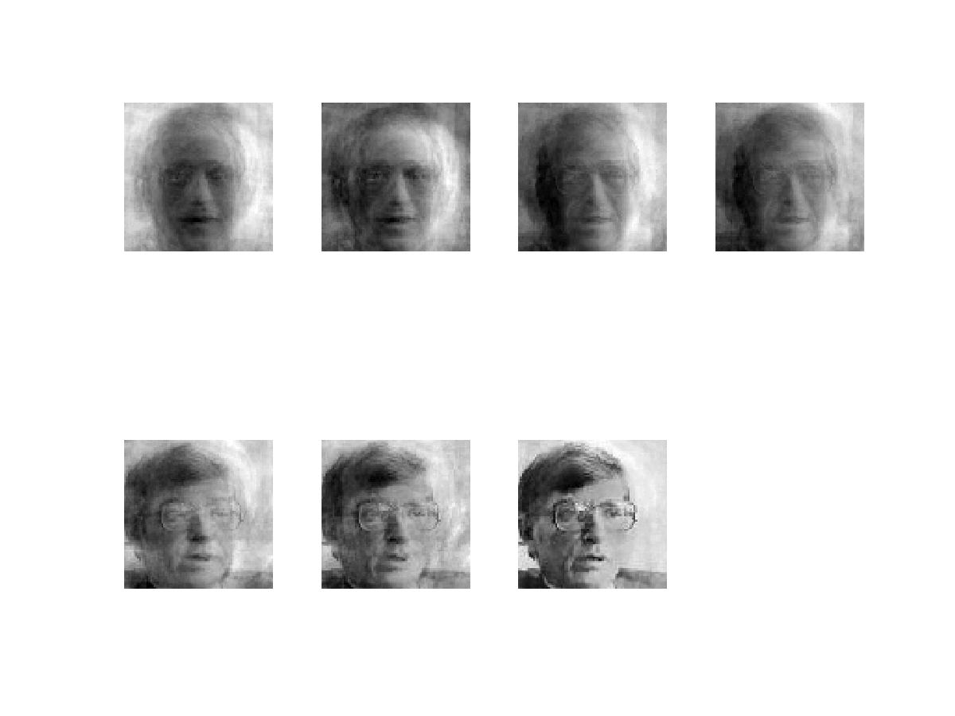
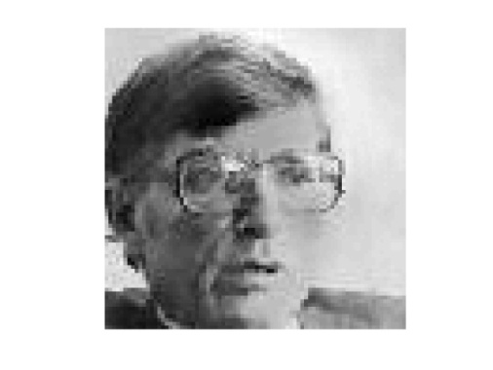
Applications -- PCA for face image compression
Original Image
n=1024
d=1
d=2
d=4
d=8
d=16
d=32
d=64
d=100
n is the original dimension and d is the reduced dimension

Slide 40
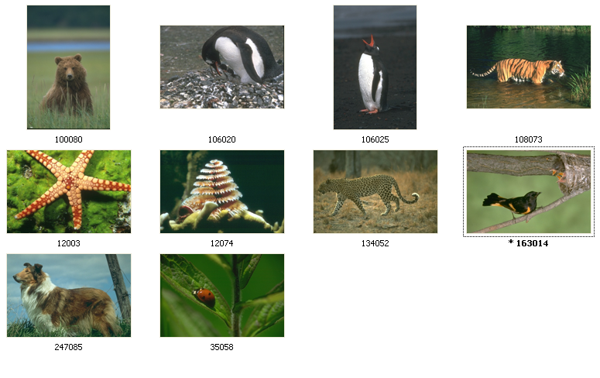
Training set
Applications -- Eigen Pictures

Slide 41

Sketches of objects (对象的草图) in Pictures: Extracted by the main eigenvectors of PCA
Eigen Pictures

Slide 42
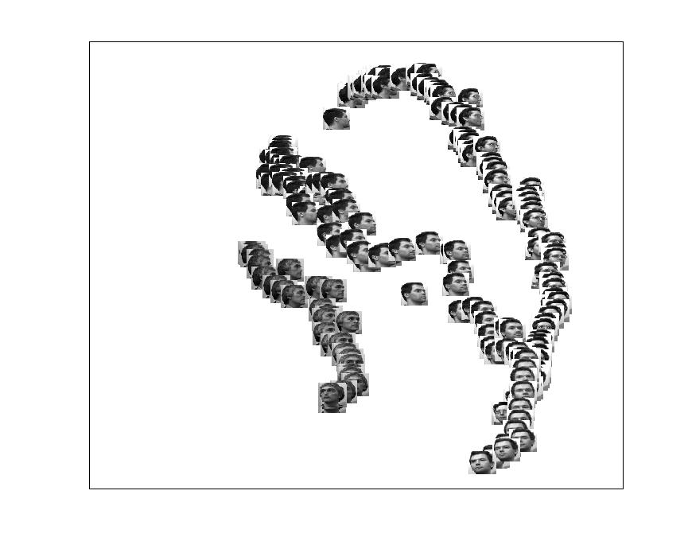
Applications -- face manifold visualization
Person 2
Person 3
UMIST
Face
Database
(n=1024)
Person 1
Embeddings the faces into a d(=2) dimensional space

Slide 43
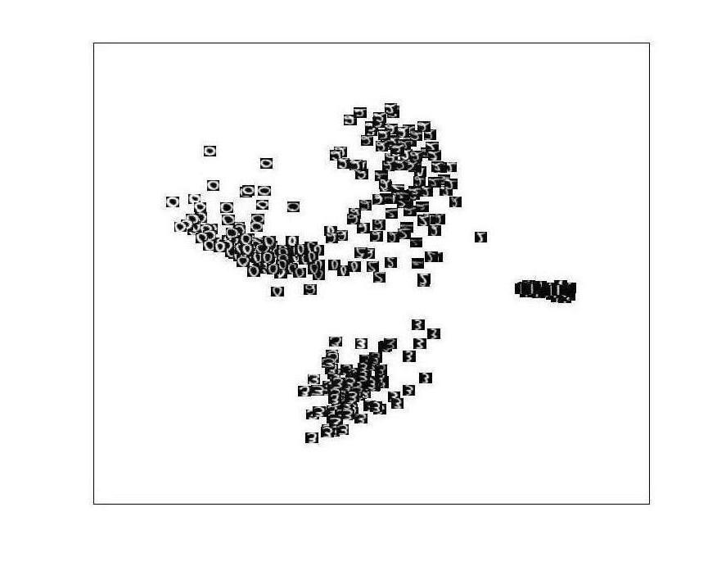
Applications -- handwritten digital visualization
Number ‘0’
USPS
Database
(n=256)
Number ‘3’
Number ‘1’
Embeddings the digits into a d(=2) dimensional space

Slide 44
Applications - object manifold visualization
COIL-20
Object
Database
(n=1024)
Embeddings the objects into a d(=2) dimensional space

Slide 45
Data Reduction 2: Numerosity Reduction
Reduce data volume by choosing alternative, smaller forms (in volume ) of data representation
Parametric methods (e.g., regression)
Assume the data fits some model, estimate model parameters, store only the parameters, and discard the data (except possible outliers)
Ex.: Log-linear models—obtain value at a point in m-D space as the product on appropriate marginal subspaces
Non-parametric methods
Do not assume models
Major families: histograms, clustering, sampling, …

Slide 46
Parametric Data Reduction: Regression and Log-Linear Models
Linear regression
Data modeled to fit a straight line
Often uses the least-square method to fit the line
Multiple regression
Allows a response variable Y to be modeled as a linear function of multidimensional feature vector
Log-linear model
Approximates discrete multidimensional probability distributions

Slide 47
Regression Analysis
y
Y1
Regression analysis: A collective name for techniques for the modeling and analysis of numerical data consisting of values of a dependent variable (also called response variable or measurement) and of one or more independent variables (aka. explanatory variables or predictors)
The parameters are estimated so as to give a "best fit" of the data
Most commonly the best fit is evaluated by using the least squares method, but other criteria have also been used
Y1’
y = x + 1
X1
x
Used for prediction (including forecasting of time-series data), inference, hypothesis testing, and modeling of causal (因果) relationships

Slide 48
Regress Analysis and Log-Linear Models
Linear regression: Y = w X + b
Two regression coefficients, w and b, specify the line and are to be estimated by using the data at hand
Using the least squares criterion to the known values of Y₁, Y₂, …, X₁, X₂, ….
Multiple regression: Y = b₀ + b₁ X₁ + b₂ X₂
Many nonlinear functions can be transformed into the above
Log-linear models:
Approximate discrete multidimensional probability distributions
Estimate the probability of each point (tuple) in a multi-dimensional space for a set of discretized attributes, based on a smaller subset of dimensional combinations
Useful for dimensionality reduction and data smoothing

Slide 49
Histogram Analysis
Divide data into buckets and store average (sum) for each bucket
Partitioning rules:
Equal-width: equal bucket range
Equal-frequency (or equal-depth)
Notes:
Removed 09/09/10: V-optimal: with the least histogram variance (weighted sum of the original values that each bucket represents)

Slide 50
Clustering
Partition data set into clusters based on similarity, and store cluster representation (e.g., centroid and diameter，质心和直径) only
Can be very effective if data is well clustered, but not if data is “smeared (涂污)”
Can have hierarchical clustering and be stored in multi-dimensional index tree structures
There are many choices of clustering definitions and clustering algorithms
Cluster analysis will be studied in depth in later Chapter

Slide 51
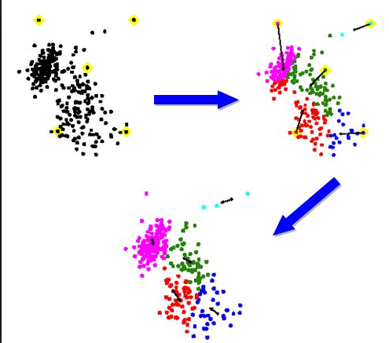
Clustering
Centroids
Original data
Clustered data

Slide 52
Sampling （抽样）
Sampling: obtaining a small sample s to represent the whole data set N
Key principle: Choose a representative subset of the data
Simple random sampling may have very poor performance in the presence of skew (扭曲)
Develop adaptive sampling methods, e.g., stratified sampling （分层抽样）

Slide 53




Image Sampling （图像采样）
采样点数与图像质量之间的关系
(a)
(b)
(c)
(d)
(a) 采样点 256×256 时的图像
(b) 采样点 64×64 时的图像
(c) 采样点 32×32 时的图像
(d) 采样点 16×16 时的图像
采样越细，越能精细地表现图像。采样点减少时，块状效应明显。

Slide 54
Types of Sampling
Simple random sampling
There is an equal probability of selecting any particular item
Sampling without replacement
Once an object is selected, it is removed from the population （种群）
Sampling with replacement
A selected object is not removed from the population
Stratified sampling（分层采样）:
Partition the data set, and draw samples from each partition proportionally, ( i.e., approximately the same percentage of the data)
Used in conjunction （关联）with skewed data

Slide 55
Sampling: With or without Replacement
SRSWOR
(simple random
sample without
replacement)
SRSWR
(simple random
sample with
replacement)
Raw Data （原始数据）

Slide 56
Sampling: Cluster or Stratified Sampling
Raw Data
Cluster/Stratified Sample

Slide 57
Data Reduction 3: Data Compression
String compression（字符串压缩）
There are extensive theories and well-tuned algorithms
Typically lossless, but only limited manipulation is possible without expansion
Audio/video compression
Typically lossy compression, with progressive refinement
Sometimes small fragments of signal can be reconstructed without reconstructing the whole
Image compression
Such as, resizing the images, sampling, etc
Dimensionality and numerosity reduction may also be considered as forms of data compression
Notes:
57
PCA and Wavelet are forms of data compression also.

Slide 58
Data Compression
数据压缩是指在不丢失有用信息的前提下，缩减数据量以减少存储空间，提高其传输、存储和处理效率的一种技术方法。
无损数据压缩（Lossless Compression）是指使用压缩后的数据进行重构（或者叫做还原，解压缩），重构后的数据与原来的数据完全相同。无损压缩用于要求重构的信号与原始信号完全一致的场合。
有损数据压缩（Lossly Compression）是一种经过压缩、解压的数据与原始数据不同但是非常接近的压缩方法。适用于重构信号不一定非要和原始信号完全相同的场合，如图像和声音的压缩就可以采用有损压缩，因为其中包含的数据往往多于我们的视觉系统和听觉系统所能接收的信息，丢掉一些数据而不至于对声音或者图像所表达的意思产生误解，但可大大提高压缩比。
Notes:
58

Slide 59
Data Compression
Original Data
Compressed
Data
lossless
Original Data
Approximated
lossy
Notes:
59

Slide 60
Data Preprocessing: Outline
Data Preprocessing: An Overview
Data Quality
Major Tasks in Data Preprocessing
Data Cleaning
Data Integration
Data Reduction
Data Transformation
Linear Algebra (线性代数)
Summary
Notes:
60

Slide 61
Data Transformation
A function that maps the entire set of values of a given attribute to a new set of replacement values s.t. each old value can be identified with one of the new values
Methods
Smoothing: Remove noise from data
Attribute/feature construction
New attributes constructed from the given ones
Aggregation（聚合）: Summarization, data cube construction
Normalization: Scaled to fall within a smaller, specified range
min-max normalization
z-score normalization
……
Notes:
61

Slide 62
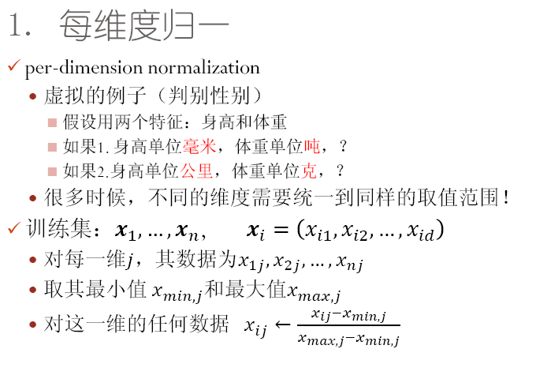
Feature Normalization

Slide 63
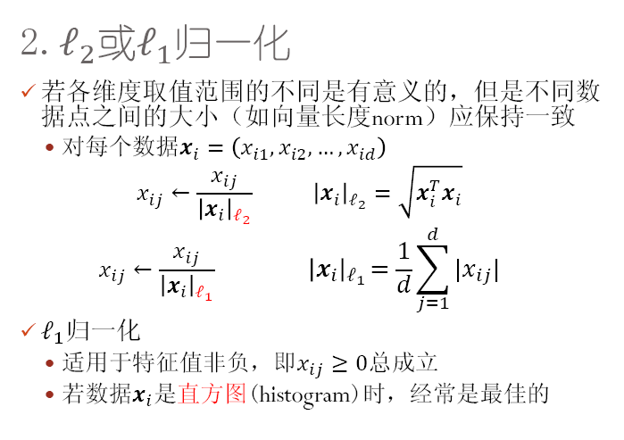
Feature Normalization

Slide 64
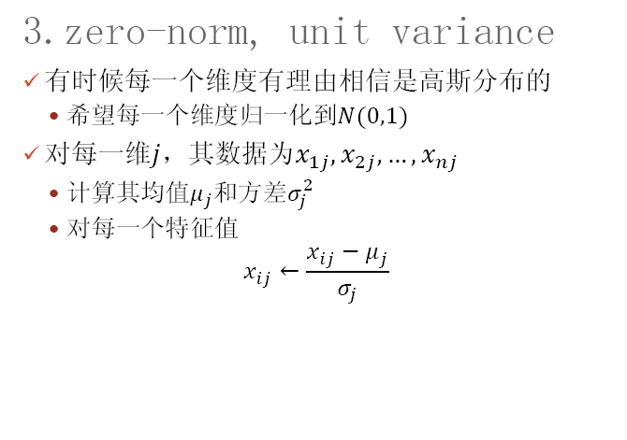
Feature Normalization

Slide 65
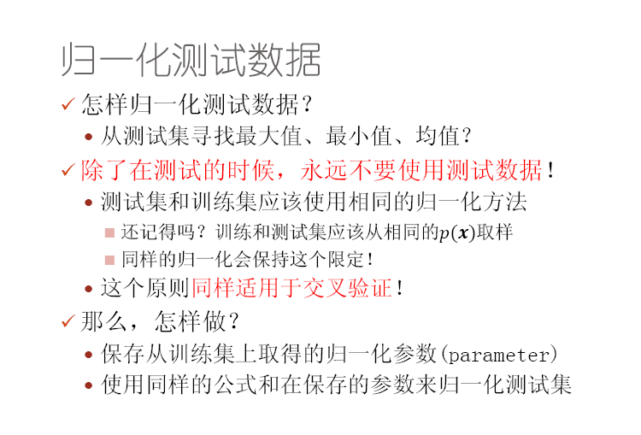
Feature Normalization

Slide 66
Data Preprocessing: Outline
Data Preprocessing: An Overview
Data Quality
Major Tasks in Data Preprocessing
Data Cleaning
Data Integration
Data Reduction
Data Transformation
Linear Algebra (线性代数)
Summary
Notes:
66

Slide 67
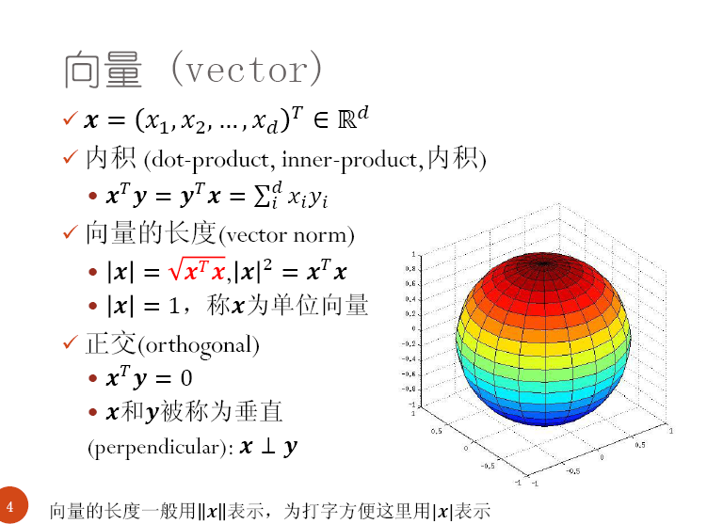
Linear Algebra (线性代数)
此部分内容来自于南京大学计算机系吴建鑫教授课程slides。
Notes:
67

Slide 68
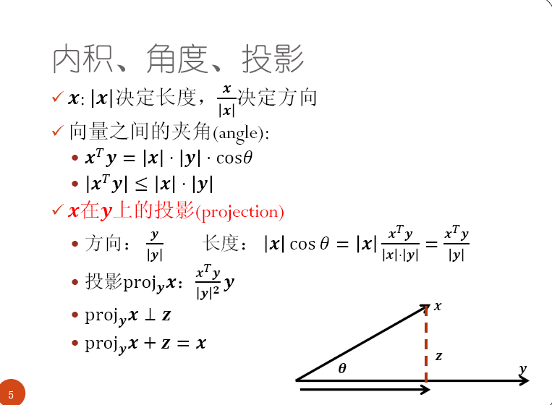
Linear Algebra (线性代数)
Notes:
68

Slide 69
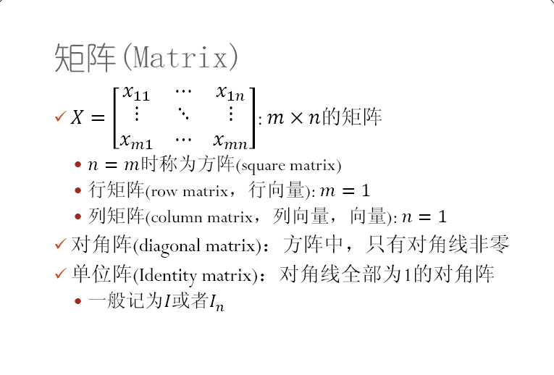
Linear Algebra (线性代数)
Notes:
69

Slide 70
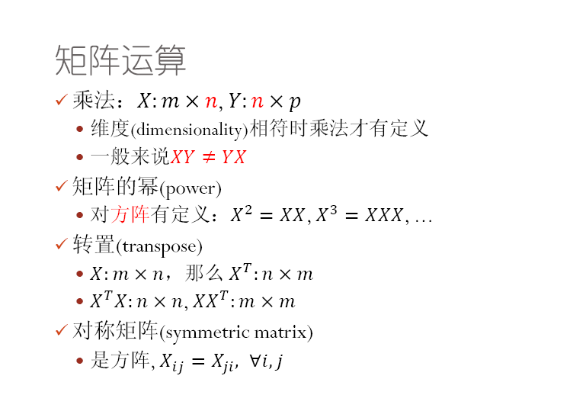
Linear Algebra (线性代数)
Notes:
70

Slide 71
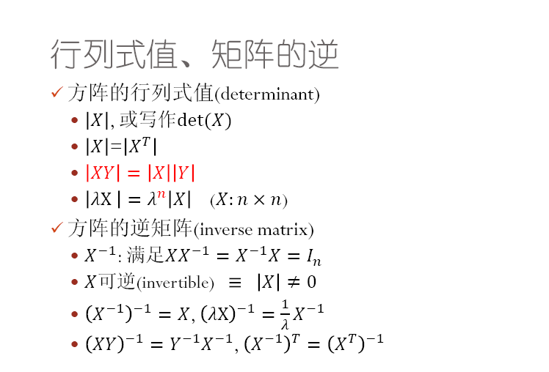
Linear Algebra (线性代数)
Notes:
71

Slide 72
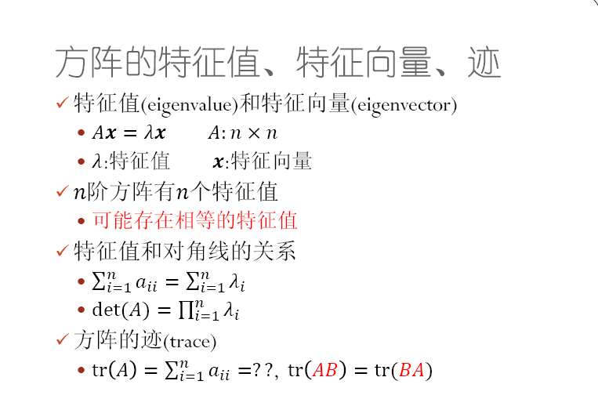
Linear Algebra (线性代数)
Notes:
72

Slide 73
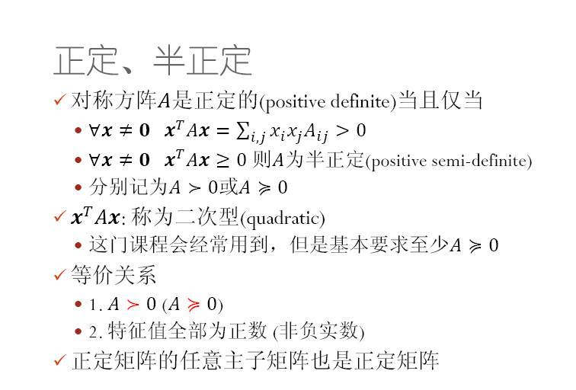
Linear Algebra (线性代数)
Notes:
73

Slide 74
Data Preprocessing: Outline
Data Preprocessing: An Overview
Data Quality
Major Tasks in Data Preprocessing
Data Cleaning
Data Integration
Data Reduction
Data Transformation
Linear Algebra (线性代数)
Summary
Notes:
74

Slide 75
Summary
Data quality: accuracy, completeness, consistency, timeliness, believability, interpretability
Data cleaning: e.g. missing/noisy values, outliers
Data integration from multiple sources:
Entity identification problem; Remove redundancies; Detect inconsistencies
Data reduction
Dimensionality reduction; Numerosity reduction; Data compression
Data transformation
Normalization

Slide 76
References
D. P. Ballou and G. K. Tayi. Enhancing data quality in data warehouse environments. Comm. of ACM, 42:73-78, 1999
T. Dasu and T. Johnson. Exploratory Data Mining and Data Cleaning. John Wiley, 2003
T. Dasu, T. Johnson, S. Muthukrishnan, V. Shkapenyuk. Mining Database Structure; Or, How to Build a Data Quality Browser. SIGMOD’02
H. V. Jagadish et al., Special Issue on Data Reduction Techniques. Bulletin of the Technical Committee on Data Engineering, 20(4), Dec. 1997
D. Pyle. Data Preparation for Data Mining. Morgan Kaufmann, 1999
E. Rahm and H. H. Do. Data Cleaning: Problems and Current Approaches. IEEE Bulletin of the Technical Committee on Data Engineering. Vol.23, No.4
V. Raman and J. Hellerstein. Potters Wheel: An Interactive Framework for Data Cleaning and Transformation, VLDB’2001
T. Redman. Data Quality: Management and Technology. Bantam Books, 1992
R. Wang, V. Storey, and C. Firth. A framework for analysis of data quality research. IEEE Trans. Knowledge and Data Engineering, 7:623-640, 1995
Notes:
MK 08.11.02: This needs to be updated to reflect changes.

